Slide 1
Land Use and Resource Management Department
How to Access & View Department Information
Mandy Bonneville
Deputy Director/County Conservationist
October 15, 2022

Slide 2
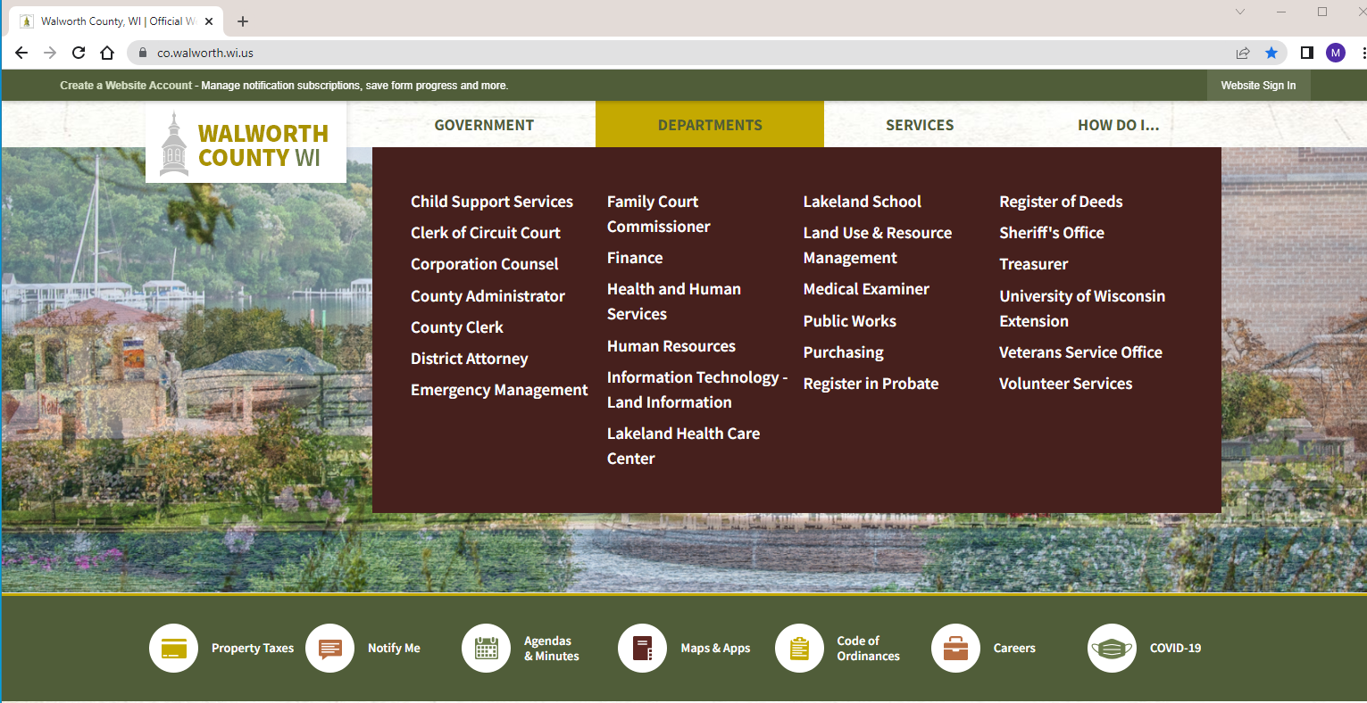
Department Webpage Access
Visit the Walworth County website at www.co.walworth.wi.us
Hover over the Departments banner at the top of the screen.
Select Land Use & Resource Management.

Slide 3
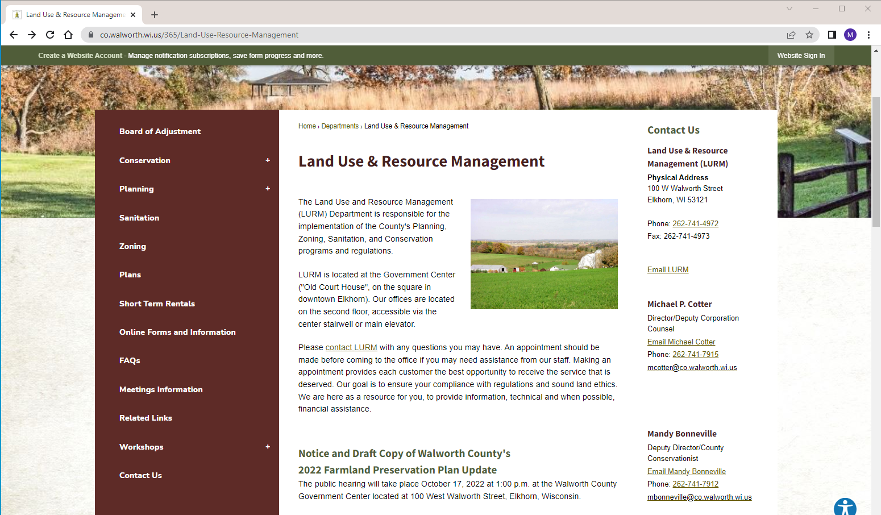
Department Webpage Access (cont’d)
Land Use & Resource Management Department Webpage

Slide 4
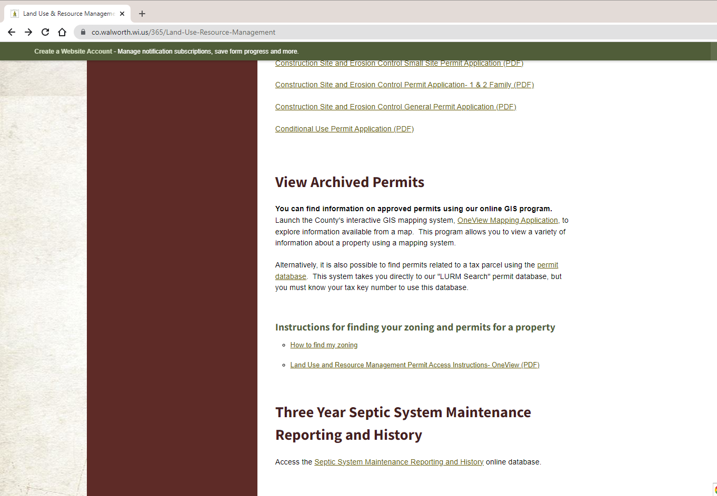
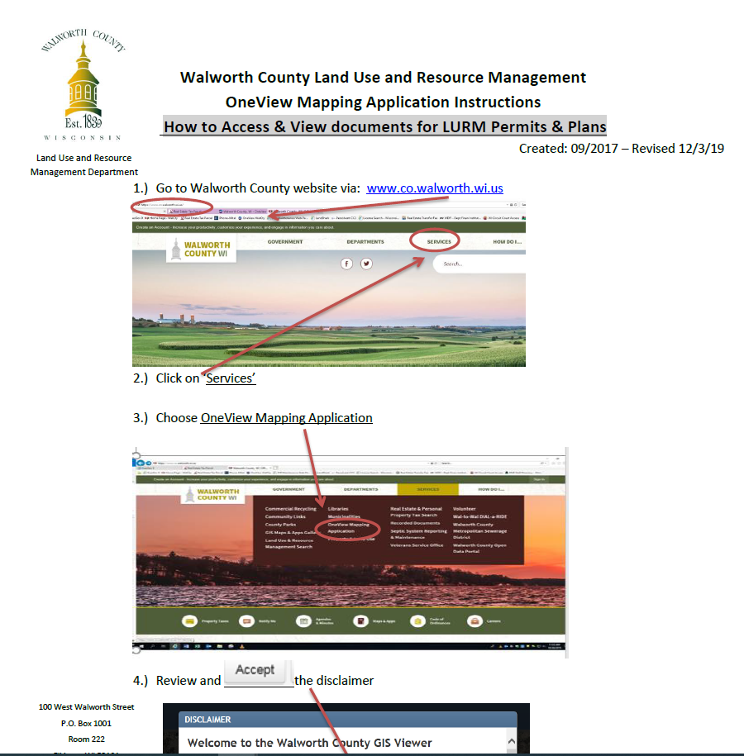
Permit Access & Viewing
Instructions to find Zoning and/or Permits for a Property
Navigate to bottom of Department homepage

Slide 5
Still Need Assistance?
Contact us. Phone and Emails provided for all staff.

Slide 6
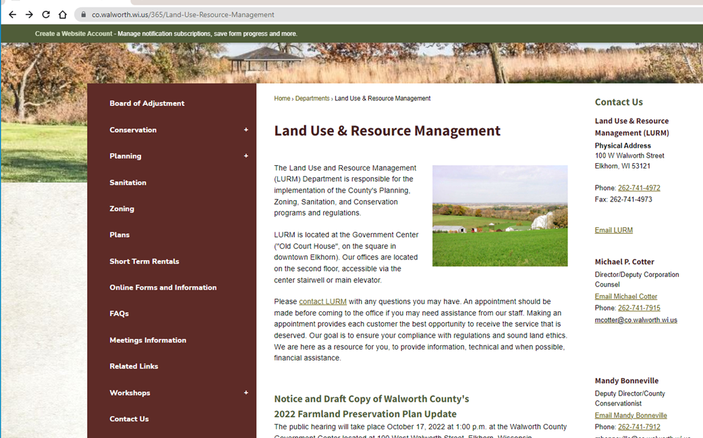
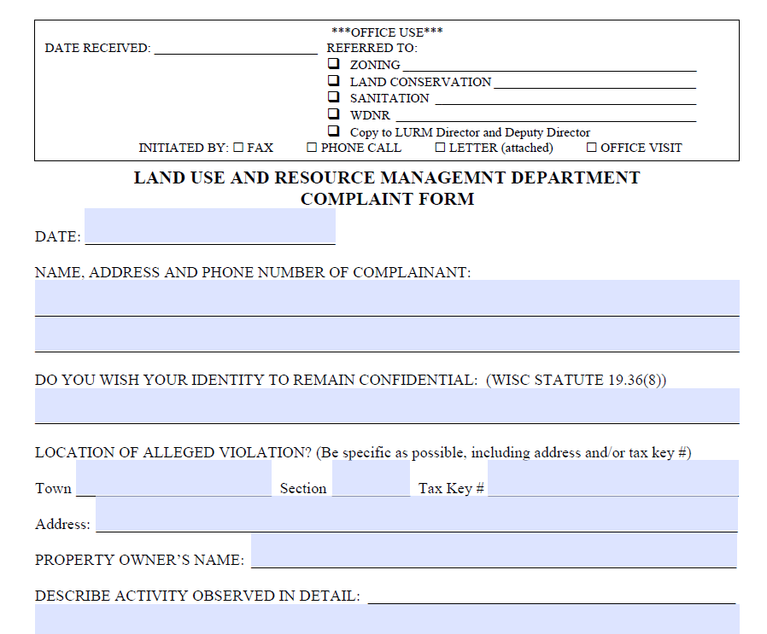
Have a Complaint or Alleged Violation?
Email or Phone Department
Online Complaint Form
Email or Phone appropriate Staff Member

Slide 7

Thank you for your time.
Any Questions?
Mandy Bonneville, Deputy Director/County Conservationist
mbonneville@co.walworth.wi.us
262-741-7912
Nick Sigmund, Senior Zoning Officer
nsigmund@co.walworth.wi.us
262-741-7918
www.co.walworth.wi.us

